Slide 1
SECURE DATA HIDING IN IMAGES USING STEGANOGRAPHY
CAPSTONE PROJECT
Presented By:
M R Gagan
CMR University (MCA)

Slide 2
OUTLINE
Problem Statement
Technology used
Wow factor
End users
Result
Conclusion
Git-hub Link
Future scope

Slide 3
Problem Statement
Keeping messages secure is important in the digital world. Traditional encryption methods can make messages stand out, making them easy targets for hackers. This project uses steganography to hide secret messages inside images, ensuring they remain unnoticed. The image looks the same, but it secretly holds the hidden data. This technique helps in safe and private communication without drawing attention.

Slide 4
Technology used
Programming Language- Python
Libraries- OpenCV (cv2), os module for image processing, NumPy for handling image data
Concepts- Steganography, Image Processing
File handling to store encryption details

Slide 5
Wow factors
Invisible Message Embedding- Messages are hidden in image pixels.
Passcode Protection- Only authorized users can retrieve the message.
Image-Based Encryption- Unlike text-based methods, this adds a visual layer of security.

Slide 6
End users
Cybersecurity Enthusiasts learning about steganography.
Students and researchers working on digital security projects.
Individuals who want to securely share hidden messages.

Slide 7
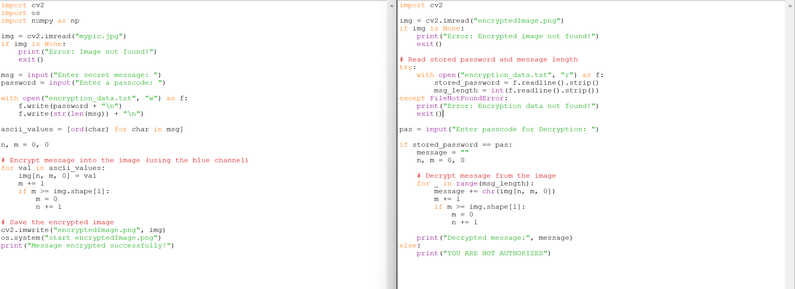
Results
Source code

Slide 8
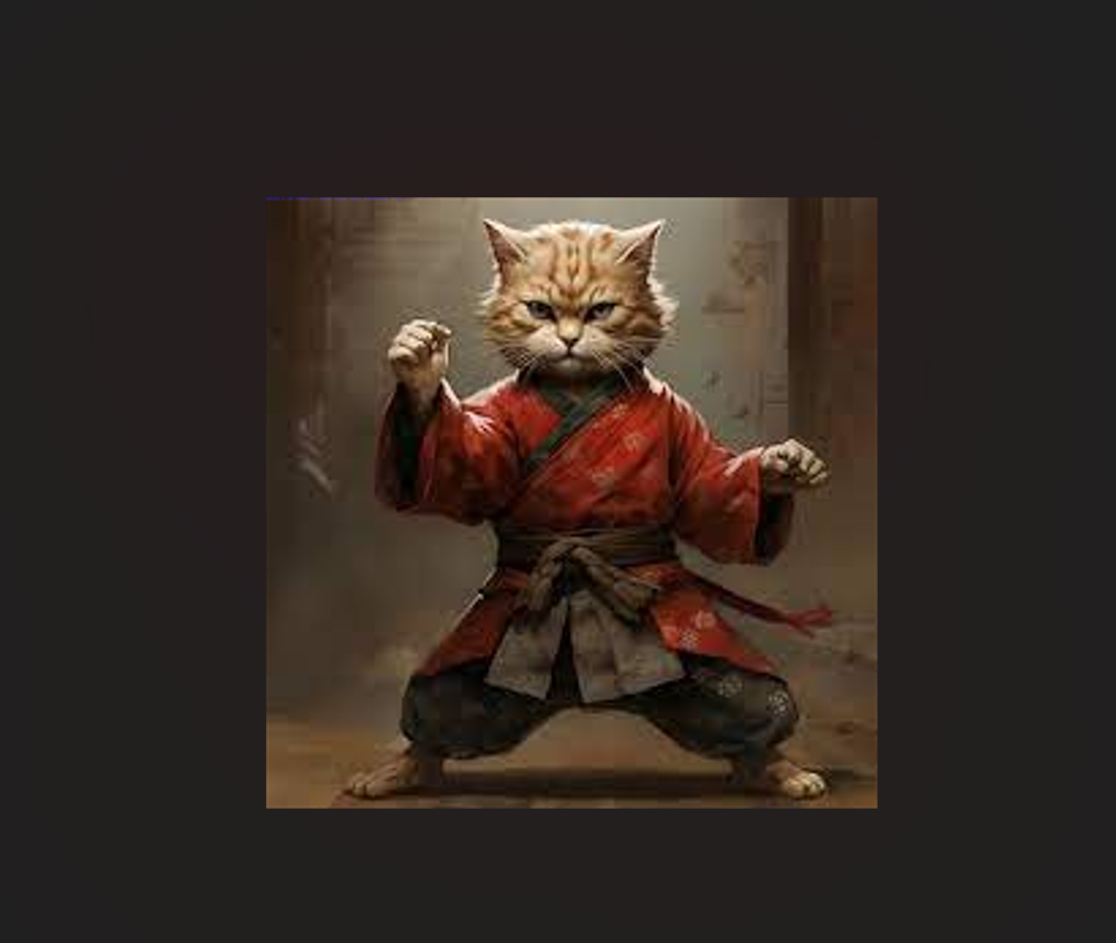
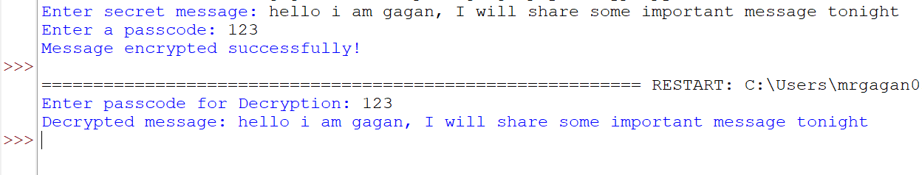
Output

Slide 9
Conclusion
This project is a simple and effective way to hide secret messages inside images. It makes sharing messages more secure without making it obvious. This method is creative and helps keep information safe from others.

Slide 10
GitHub Link
https://github.com/mrgagan17/steganography.git

Slide 11
Future scope(optional)
Add AES encryption for extra security before hiding the message.
Support more image formats like PNG and BMP for flexibility.
Create a user-friendly interface (GUI) to make it easier to use.

Slide 12
THANK YOU

